Slide 1
MELOSCRIBE
Generating Music and Piano notes from Text Descriptions
Group 12
Ashwanth Kuppusamy
Chelsi Jain
Dharun Narayanan Lakshminarayanan Komethagavelu
Shrirang Patil

Slide 2
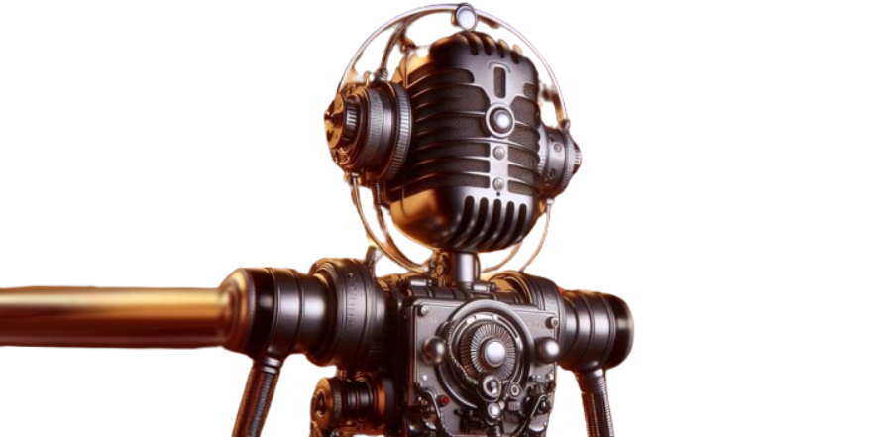
Problem Statement
The goal of the Meloscribe project is to develop an end-to-end system that can use simple textual descriptions as prompt to generate piano music audio and its corresponding readable piano sheet notes(text/MIDI Format).

Slide 3
Limitations
Existing methods revolves around either transcribing textual descriptions to music or music to instrumental notes.
There is no end to end system that can produce both music and instrumental notes from textual descriptions.

Slide 4
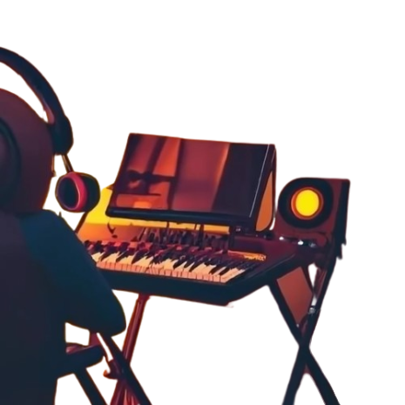
Who Cares?
People without formal musical training who wants to add their own custom royalty free music to their videos or other content creators.
People who wants to distribute the notes for the music in their content for reproducibility. This can streamline the process of transcribing music for professional musicians and composers.

Slide 5


Dataset
MusicCaps⁵ NSynth⁶
TEXT
MusicCaps is a dataset composed of 5.5k music-text pairs, with rich text descriptions provided by human experts. For each 10-second music clip.
NSynth is the dataset consisting of approximate 300k one-shot instrumental notes and audio waveforms from 1006 different instruments.
Alternate Dataset for Conversion from Audio Waveform to Piano Notes - Maestro

Slide 6
Proposed Solution
Text - to - Waveform
Integrate the text embeddings with the musical context, like genre, tempo etc.
Input - Context Vector + Audio Embedding
Fine Tuning BERT on MusicCaps dataset and get BERT’s embeddings
Train a neural network to get the context vector
Design a hybrid model combining a (CVAE) with transformer
Train the model on the MusicCaps dataset to learn generating music representations that are relevant to the text embeddings
Waveform

Slide 7
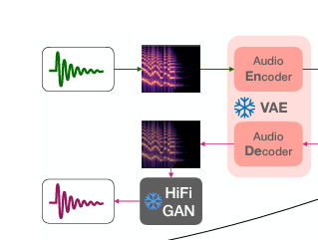
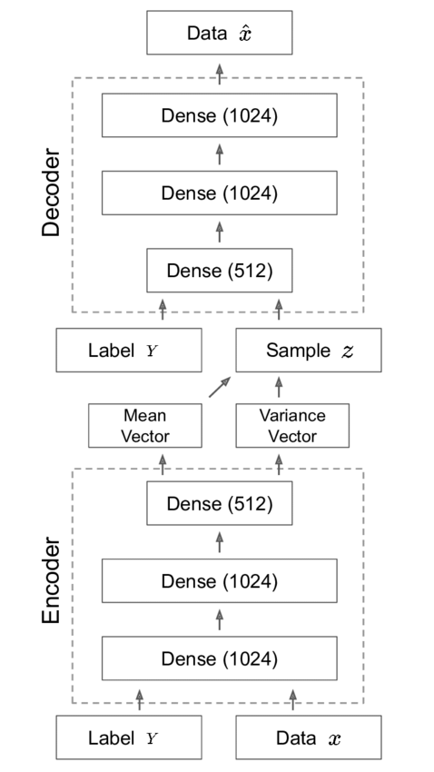
Architecture
CVAE architecture

Slide 8
Proposed Solution
Waveform - to - Piano Notes
Text
Tokenize
Use an embedding layer to integrate audio and text features
Fine-tune the pre-trained transformer model on NSynth dataset
Piano Notes
Waveform
Convert to a spectogram

Slide 9
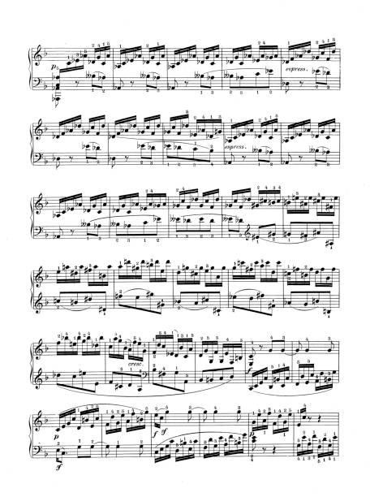

Expected Outcomes
The outcome from the CVAE architecture is a high fidelity waveform or audio relevant to the given text prompt.
The outcome from the trained or fine tuned transformer to piano notes for the generated music.
Notes:
This includes better performance on adversarial test sets, demonstrating the models' ability to correctly classify birds even when faced with manipulated images.

Slide 10
Risks & Challenges
The project faces challenges in accurately translating text descriptions into realistic musical compositions and handling polyphonic audio transcription accurately as well as ensuring precise transcription into sheet music.
Evaluations could involve subjective listening tests to assess the quality of generated music, and objective evaluations of transcription accuracy on a held-out dataset. The final end-to-end evaluation, where users provide text descriptions, and the system's outputs audio and sheet music. Baseline evaluation will also be included.

Slide 11
Timeline
TASK | ESTIMATED TIME
Literature Review | May 1 - May 5
Environment Dataset Setup | May 6 - May 8
Task 1 - Text-to-Waveform | May 8 - May 24
Task 2 - Waveform - to -piano notes | May 24 - June 5
Evaluation | June 5 - June 8

Slide 12
References
Wu, Shangda, Dingyao Yu, Xu Tan, and Maosong Sun. "CLaMP: Contrastive Language-Music Pre-training for Cross-Modal Symbolic Music Information Retrieval." 2023. Available at arXiv:2304.11029.
Lu, Peiling, Xin Xu, Chenfei Kang, Botao Yu, Chengyi Xing, Xu Tan, Jiang Bian. "MuseCoco: Generating Symbolic Music from Text." 2023. Available at arXiv:2306.00110.
Zeng, Mingliang, Xu Tan, Rui Wang, Zeqian Ju, Tao Qin, and Tie-Yan Liu. "MusicBERT: Symbolic Music Understanding with Large-Scale Pre-Training." Findings of the Association for Computational Linguistics: ACL-IJCNLP 2021, pp. 791–800. Online, August 2021. ACL Anthology.
Wang, Lei, Ziyi Zhao, Hanwei Liu, Junwei Pang, Yi Qin, Qidi Wu. "A Review of Intelligent Music Generation Systems." 2022. Available at arXiv:2211.09124.
Chou, Shih-Lun, Cheng-I Jeff Lai, and Alexander H. Liu. "MusicCaps: Connecting Music, Vision, and Language via Semantically Rich Textual Captions." 2021. Available at arXiv:2104.14100.
Engel, Jesse, et al. "Neural Audio Synthesis of Musical Notes with WaveNet Autoencoders." 2017. Available at arXiv:1704.01279.
Dhariwal, Prafulla, et al. "Jukebox: A Generative Model for Music." 2020. Available at arXiv:2005.00341.

Slide 13
Thank You

